Slide 1
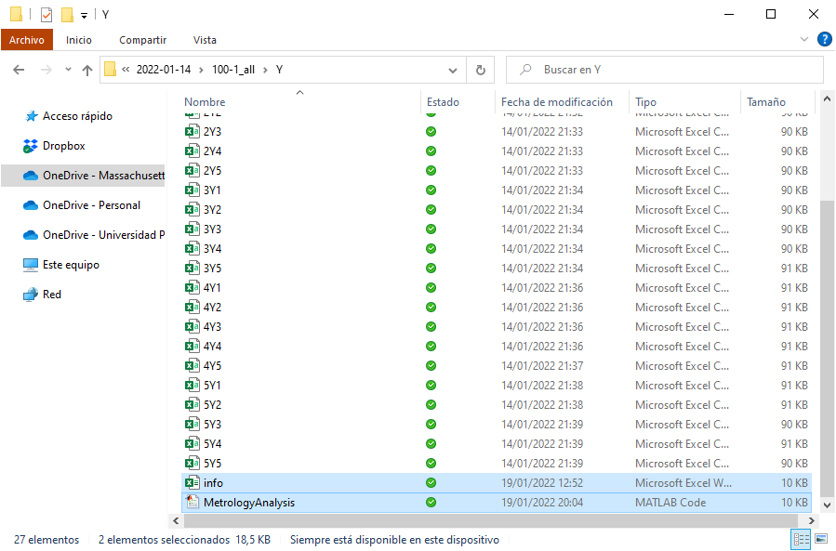
Data Analysis
Copy the “MetrologyAnalysis.m” and the “info.xlsx” files into the folder where all the csv files to be processed are.

Slide 2
Data Analysis
Open the “info” sheet and fill out/modify the information. Close it after editing (Matlab will complain if the file is still opened by a different application).

Slide 3
Data Analysis
Parameter | Example value | Description
dim | 1 | Dimension along which the data was measured (1 for X, 2 for Y)
h | 100 | Layer height (um)
n | 3 | Number of layers per step
Nsteps | 10 | Number of vertical steps in the structure
edge_start | 0 | Number of data points to be discarded at the start of the dataset
edge_end | 0 | Number of data points to be discarded at the end of the dataset
stepMargin | 30 | Number of data points considered part of a step transition, to each side of the step
Zfraction | 3 | Steps are found by searching for steep height increments of value [h*n*(1-1/Zfraction)] within a short data span (defined by 2*stepMargin)
Nz | 5 | Number of data samples taken per file, per step, for computation of averages and standard deviations of step heights - This number of samples is taken to the left and to the right of the structure, so the final number of samples is TWICE this parameter
Nxy | 3 | Number of data samples taken per file, per step, for computation of averages and standard deviations of step widths
stepIncr | 300 | In-plane step increment, as defined in CAD (used for comparison)
topWidth | 440 | Width of top step, as defined in CAD (used for comparison)
smoothener | 100 | Number of data points used to smoothen the dataset in order to identify steps
csvType | 1 | csv file format. It can differ, depending on the settings of the computer where the csv files have been created. See “info.xlsx” for examples
Open the “info” sheet and fill out/modify the information.

Slide 4
Data Analysis
Make sure that the Statistics and Machine Learning Toolbox is added to Matlab (Home – Add-Ons) if you want Matlab to output the CAD vs measurements comparison. Otherwise, comment that block (from line ~200).
Run code in Matlab.
The following slides explain what the code does.
The later slides show some troubleshooting suggestions.

Slide 5
Data Analysis
Matlab reads the “info” file and every “.csv” file stored in the same directory where the code is.
For each “.csv” data file, Matlab processes the information as follows:

Slide 6

Data Analysis
Trim data:
A number of data points are discarded from the beginning and the end of the dataset, as per the values specified in the “info” file through the “edge_start” and “edge_end” parameters.

Slide 7
Data Analysis
Determine in-plane position of steps:
A smoothened version of the dataset is computed with a moving average function, using the number of samples specified by the parameter “smoothener” in the “info” file.

Slide 8
Data Analysis
Determine in-plane position of steps:
The smooth dataset is swept searching for steep increments (rising edges) and decrements (falling edges). The parameter “stepMargin” is used to determine within how much horizontal variation each edge must be comprised. Specifically, a height increment of h*n*(1-1/Zfraction) over a horizontal displacement of 2*stepMargin is identified as a step edge. h*n*(1-1/Zfraction) computes a reduced value of the expected step height, given by h*n.
The top step of the pyramid is divided into two separate steps to allow symmetric calculations.
If the number of identified steps does not match the expected number, computed from “Nsteps”, in the “info” file, a warning message is displayed, and the code might fail.

Slide 9
Data Analysis
Reference heights to bottom layer:
Back to the unsmoothed dataset, the height of the base of the pyramid, to the sides of the outermost steps, is averaged and subtracted.

Slide 10
Data Analysis
Determine Z position of steps:
The height of the samples within each step edge is averaged to find an estimate of the Z position of each step.

Slide 11
Data Analysis
Sample heights (Z dimension):
The height of each step is sampled “Nz” times. To do so, the space within the edges of each step, with a margin of “stepMargin”, is sampled equidistantly.

Slide 12
Data Analysis
Sample widths (in-plane dimension):
To sample the width of each step, horizontal distances from left to right of the pyramid are computed.
Since steps on the right and steps on the left are usually not at the exact same height, their intersection is determined as the valid height range.
“Nxy” heights are defined within that range, and the closest actual data point to each of those heights, in the proximity of the step edge, is taken as a sample on each side.
The difference in X (or Y) between the corresponding samples on each side of the pyramid is extracted as a width sample.

Slide 13
Data Analysis
Sample widths (in-plane dimension):
Width samples

Slide 14
Data Analysis
Results:
The average heights and widths are computed and plotted, along with their standard deviations.

Slide 15
Data Analysis
Results:
A linear regression model is fit to the measured data against the CAD dimensions.
Since the width of the top step in X seems to be especially variant, a model that discards the top step is also generated to avoid excessive conditioning by that step.

Slide 16
Data Analysis
Troubleshooting:
If an error related to reading files arises, make sure the “info” file is closed and try running again (sometimes Matlab gets confused).
If the warning message saying that not enough/too many steps have been found shows, examine the corresponding figure to decide the best solution between:
Modifying parameters “stepMargin”, “Zfraction” or “smoothener” on “info.xlsx”.
Discarding that particular dataset and extracting a new one from the confocal measurements (new profile).

Slide 17
Data Analysis
The variables “sampled_h” and “sampled_xy” contain the extracted height and width data points. Use them to compute averages and standard deviations, take them to Excel to make prettier plots…

